Slide 1





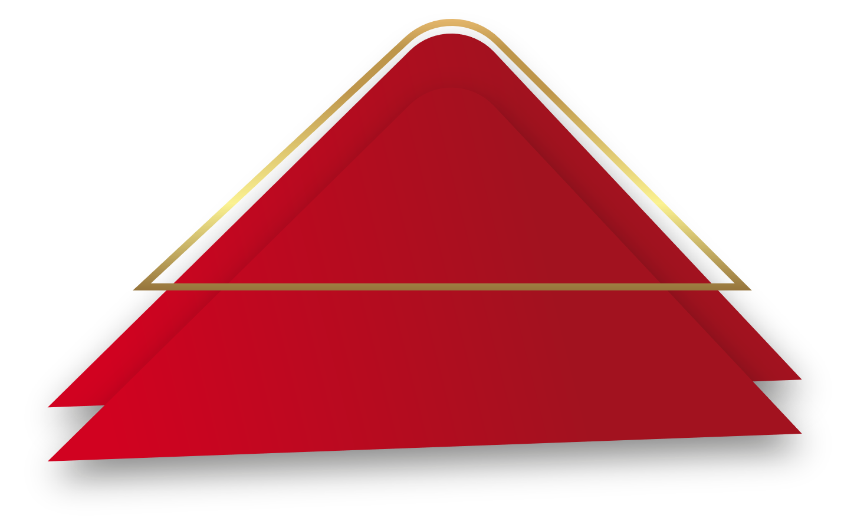
AMA 546-Presentation
Customer segmentation by clustering algorithms
23050994g ZHANG Yian
23052341g FAN Ziyao

Slide 2
行业PPT模板http://www.1ppt.com/hangye/
1
/
Dataset
2
/
Evaluation & Model
Content
3
/
Experiment
4
/
Analysis & Conclusion

Slide 3
1
Dataset
1 Introduction
2 Processing

Slide 4
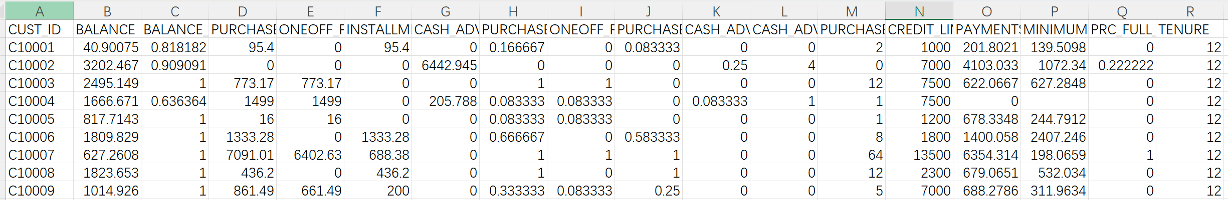
Dataset introduction
Our dataset, titled “Credit Card Dataset for Clustering”, is sourced from Kaggle.
The sample Dataset summarizes the usage behavior of about 9000 active credit card holders during the last 6 months. The file is at a customer level with 18 behavioral variables.
Data Dictionary for Credit Card dataset
Features | Meaning
BALANCE | Balance amount left in their account to make purchases
PURCHASES | Amount of purchases made from account
ONEOFF_PURCHASES | Maximum purchase amount done in one-go
CASH_ADVANCE | Cash in advance given by the user

Slide 5
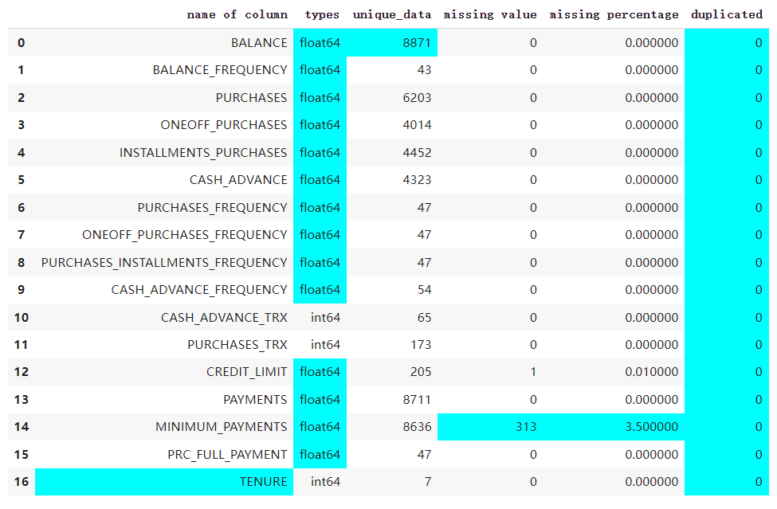
Data processing
Missing value
MINIMUM_PAYMENTS has 313 missing entries.
These missing values only account for 3.5%
We decided to remove these missing values.

Slide 6
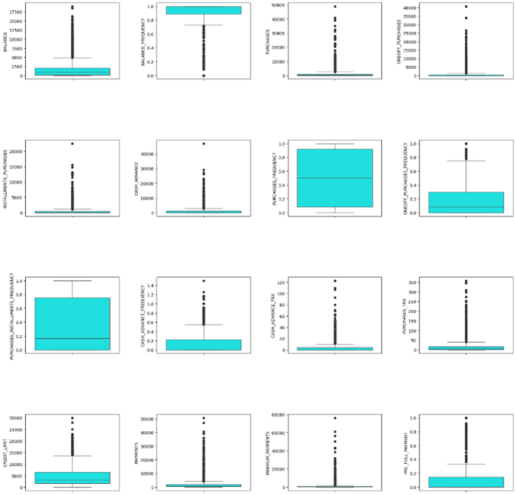
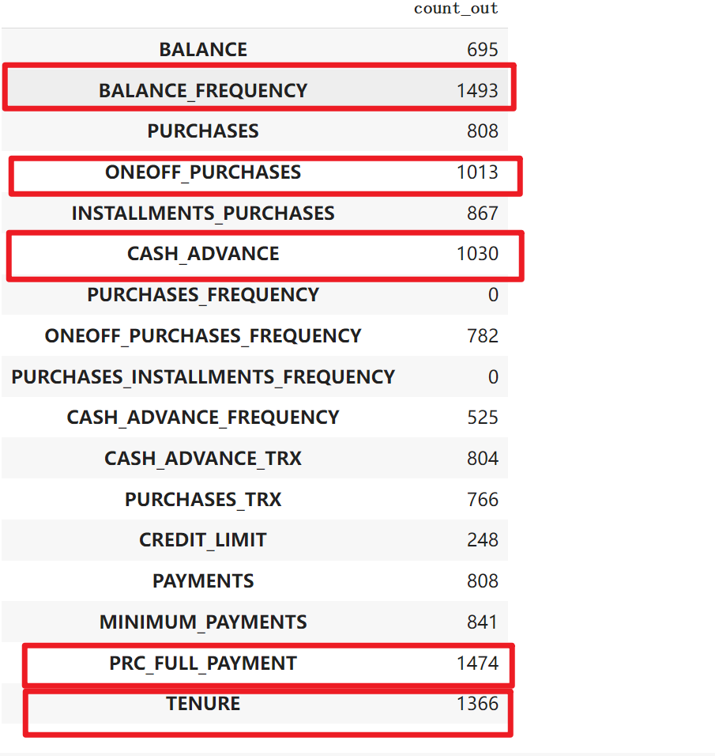
BoxPlot
Outliers counts

Slide 7
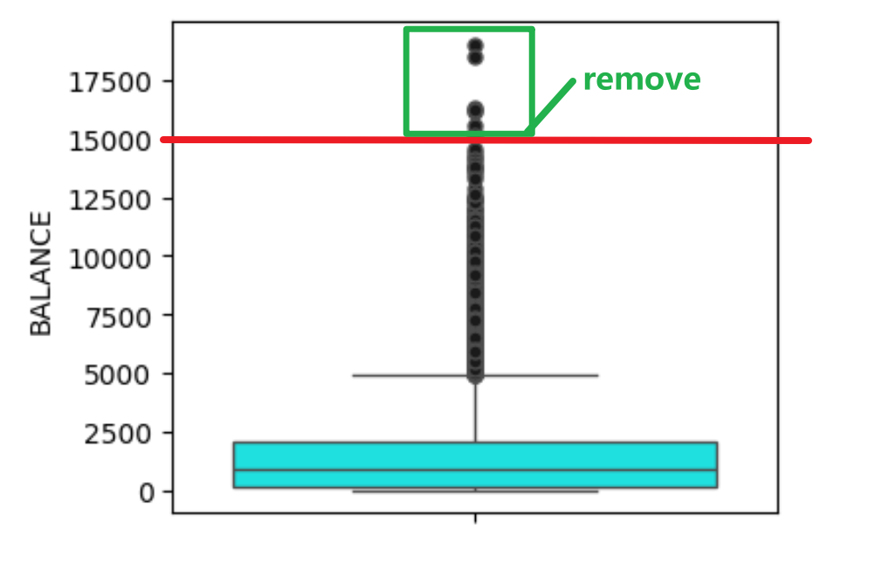
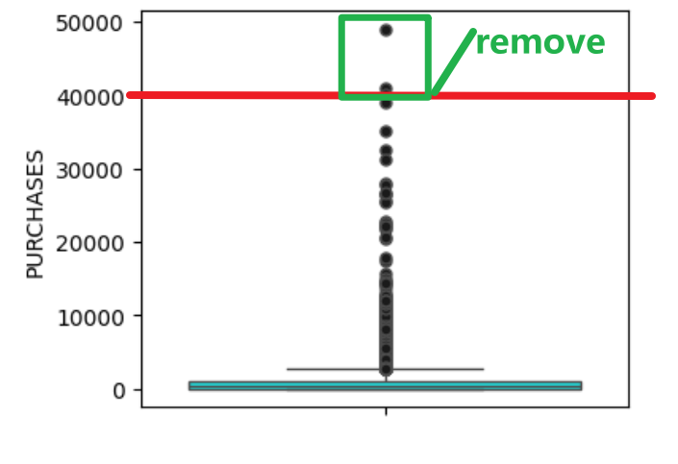
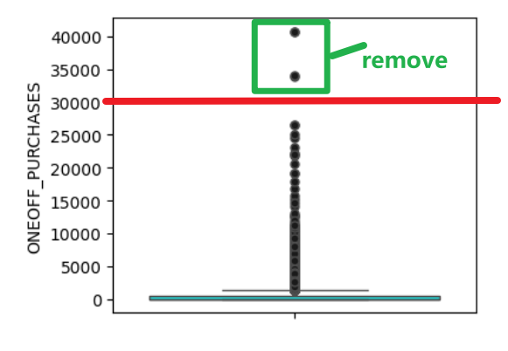
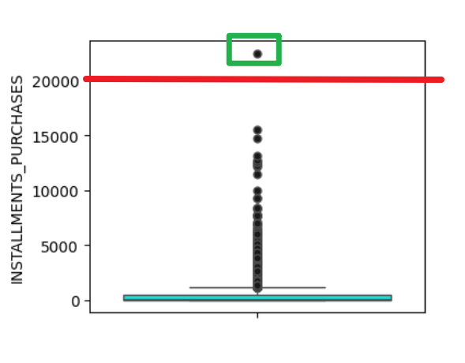
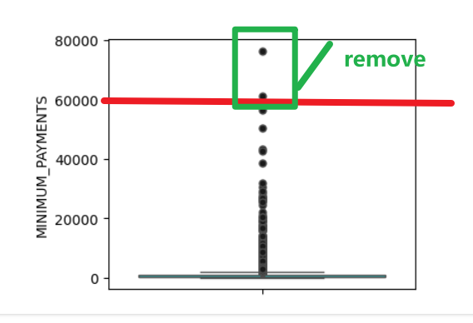
Remove the outliers
In this part, we do not remove all the outliers.is
We decided to drop some outliers which are extreme values.

Slide 8
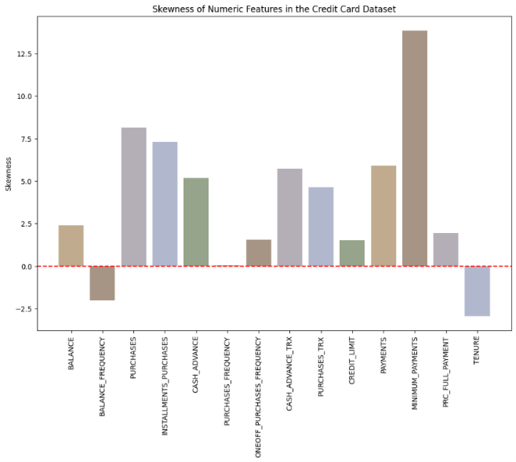
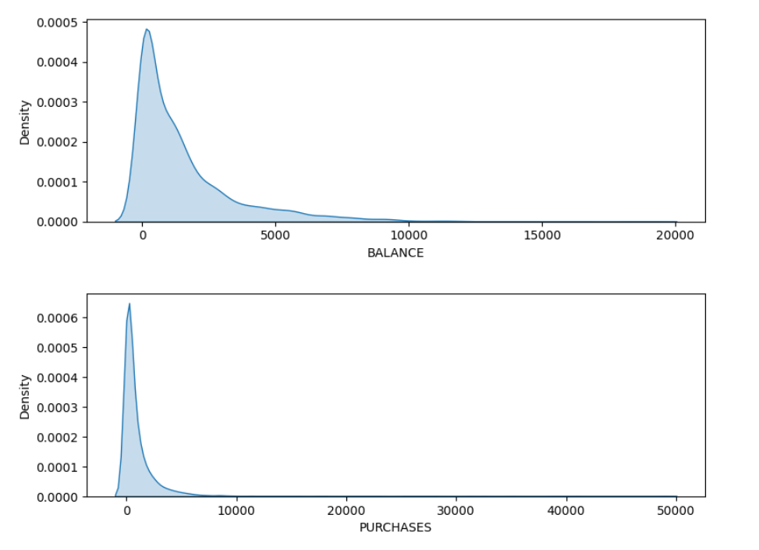
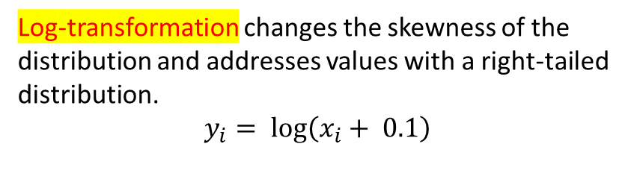
Fix the skewness problem
Log-transformation changes the skewness of the distribution and addresses values with a right-tailed distribution.
$$y_{i}= log\left(x_{i}+ 0.1\right)$$
MINIMUM_PAYMENTS,PURCHASES, CASH_ADVANCE and some other features have strong “right-skewed”.

Slide 9
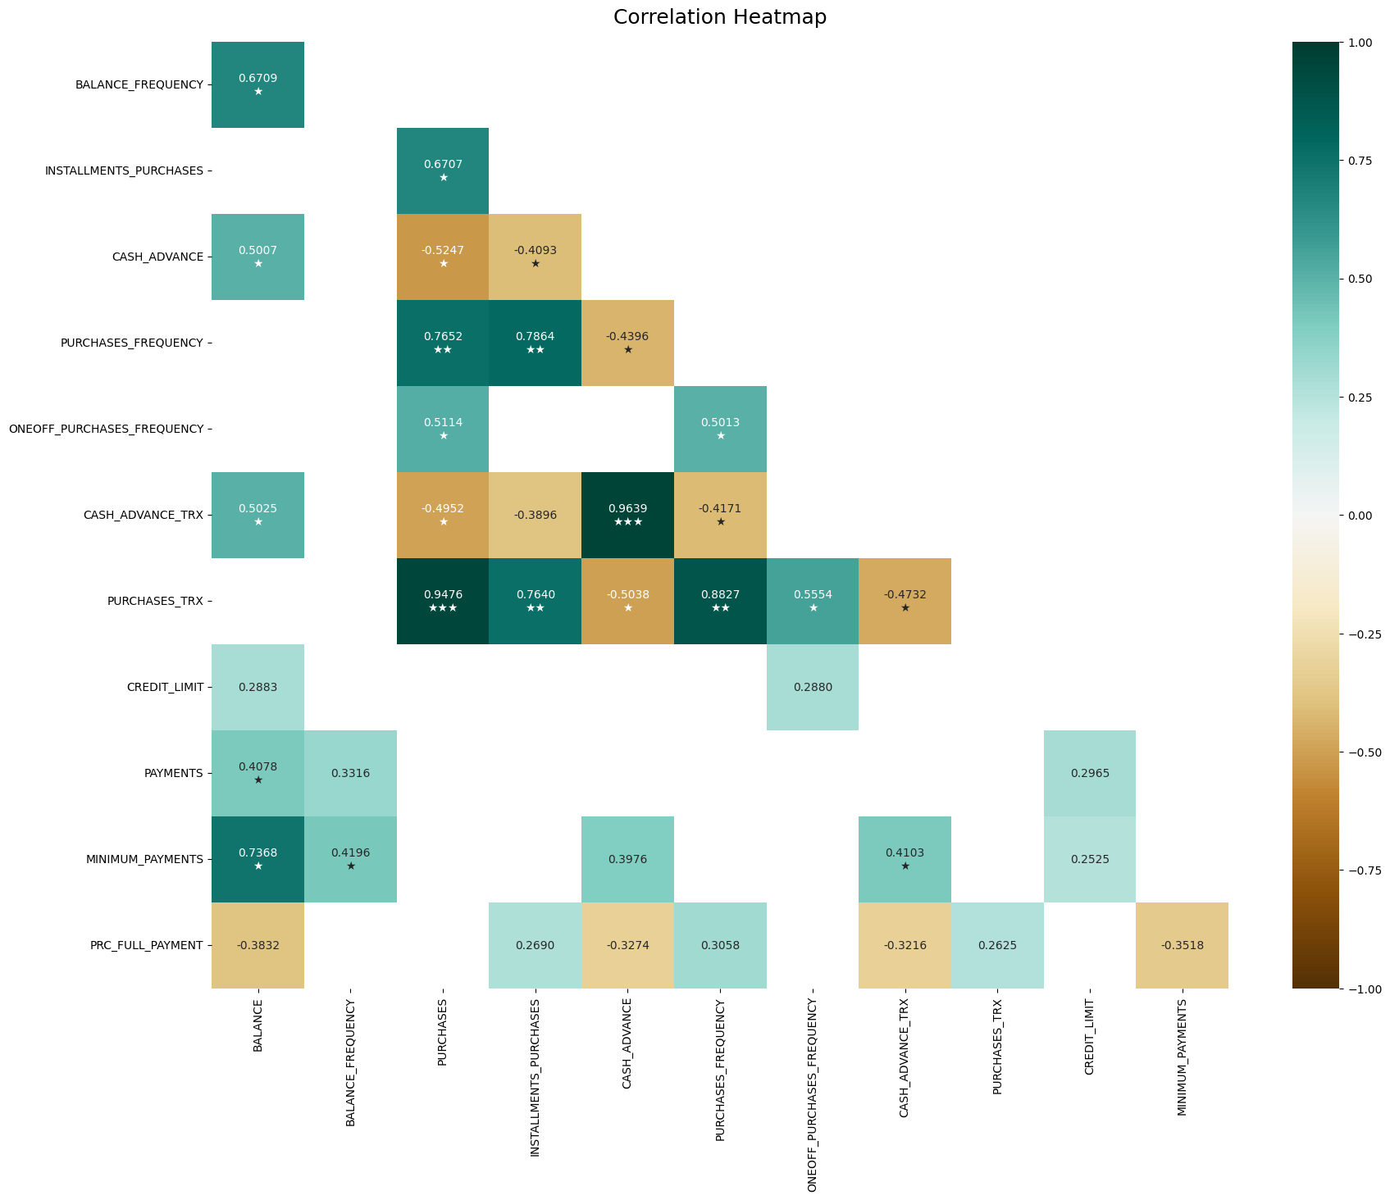
HeatMap
The correlation between “INSTALLMENTS PURCHASES” and “PURCHASES FREQUENCY”
is 0.7864, indicating a strong positive correlation between these two variables.
This suggests that customers who make purchases more frequently tend to prefer
using installment payments for these purchases

Slide 10
2
Evaluation& Model
1 Evaluation Metrics
2 K-means
3 Gaussian Mixture Model
4 Affinity Propagation Model

Slide 11
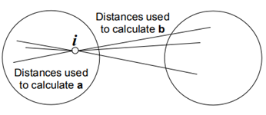
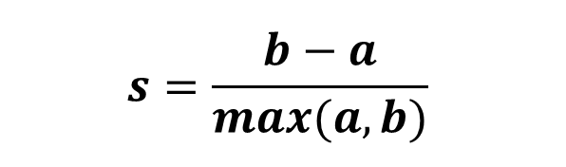
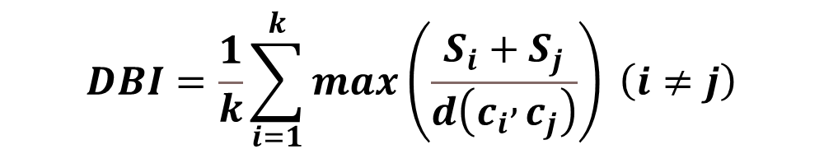

1 Evaluation Metrics
$$s=\frac{b−a}{max(a,b)}$$
Silhouette Score
$$CHI=\frac{N−k}{k−1}\frac{{SS}_{B}}{{SS}_{W}}$$
Calinski-Harabasz Index
$$DBI=\frac{1}{k}\sum_{i=1}^{k}{max\left(\frac{S_{i}+S_{j}}{d\left(c_{i} , c_{j}\right)}\right) \left(i≠j\right)}$$
Davies-Bouldin index
请在此处添加具体内容。

Slide 12
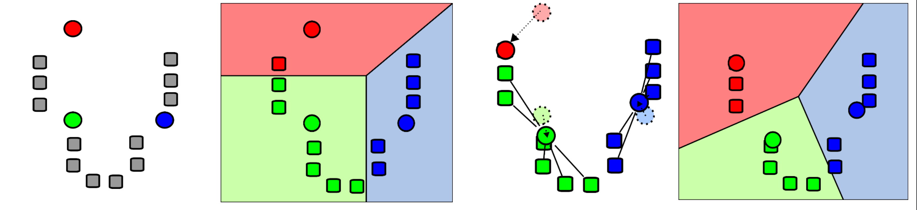
2 K-means
Basic K-means Algorithm
Choose initial centroids
Reapeat
Assign each point to a nearest centroid and update cluster centroid.
Until centroids stop changing

Slide 13
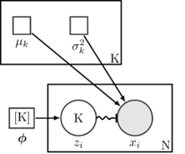
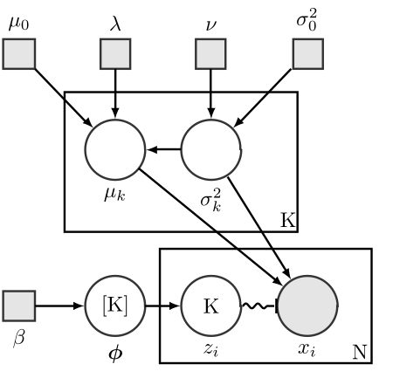
3 Gaussian Mixture Model
A clustering method based on probability density function, which assumes that each cluster is a mixture distribution composed of multiple Gaussian distributions.
When clustering, GMM assigns data points to the cluster with the highest probability, instead of hard assigning data points to a certain cluster like K-Means.
Can be applied to multiple fields, such as image recognition, speech processing, risk assessment, etc.
1
2
3

Slide 14
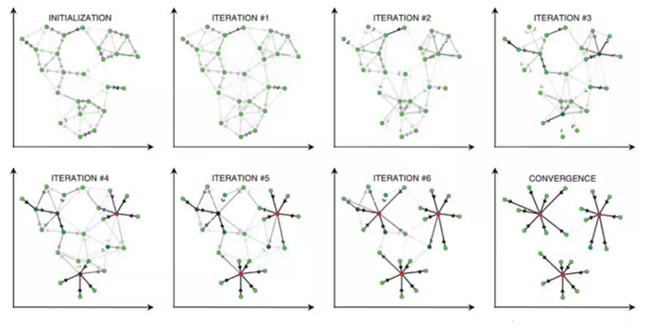
4 Affinity Propagation Model
1
A clustering algorithm used to group data points into clusters with similar characteristics.
2
Based on graph theory that determines the center point of a cluster by calculating the similarity between data points.

Slide 15
3
Experiment
1 K-means
2 Gaussian Mixture Model
3 Affinity Propagation Model

Slide 16
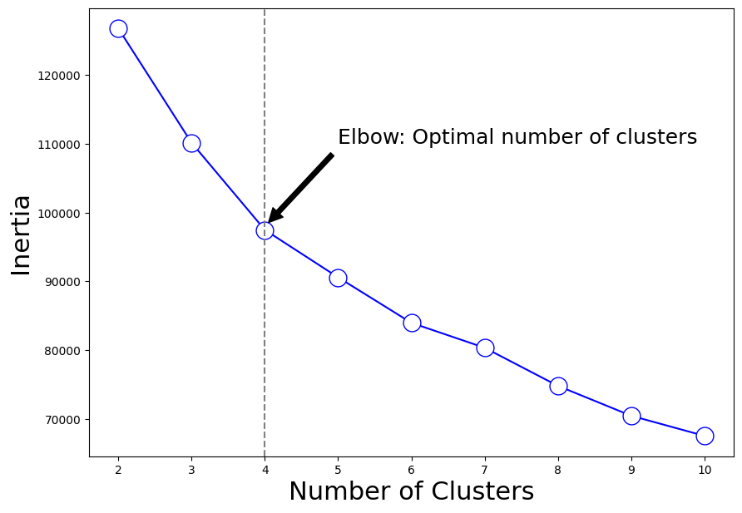
K-means
Using the Elbow Method to Determine Optimal Clustering Number k
Elbow Method Principle
Identifies the 'elbow point' where an increase in k results in diminishing returns on decrease in SSE.
Ideal k is where the curve of SSE versus k starts to flatten.
Application in project：Calculated range: k=1 to k=11.

Slide 17
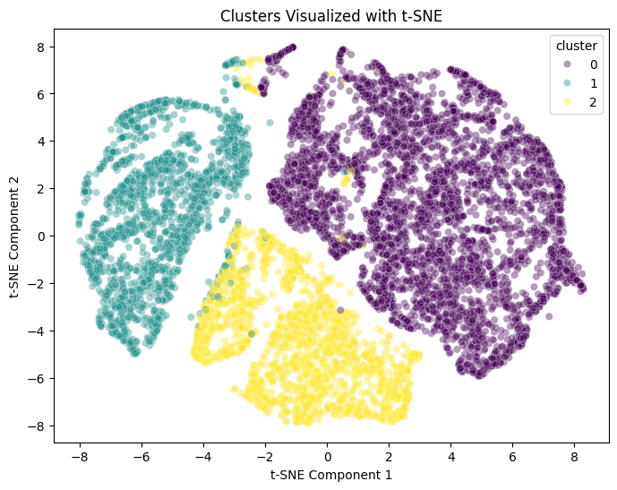
Result analysis
We utilized t-SNE to reduce the dimensions to a 2D space for visualization
Evaluation Metrics
Evaluation Metrics | score
Silhouette Score | 0.2396
Calinski-Harabasz Score | 2476.4846
Davies-Bouldin Score | 1.5397
The Silhouette Score is moderate, which indicates that while the clusters are somewhat distinct, there may be room for optimization. A score closer to 1 would be ideal.
The Calinski-Harabasz Score is relatively high, which is desirable as it suggests good cluster definition.
Davies-Bouldin Score: A value of 1.5397 indicates the average similarity between each cluster and the cluster most similar to it.

Slide 18
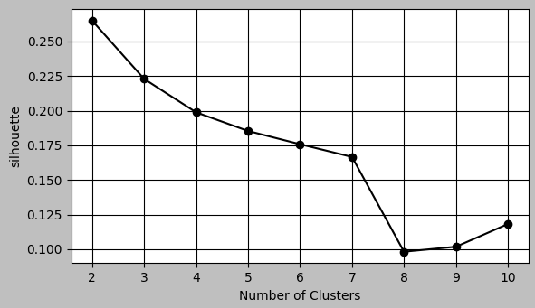
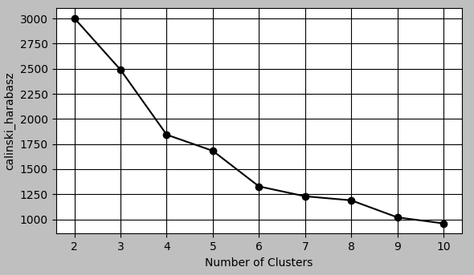
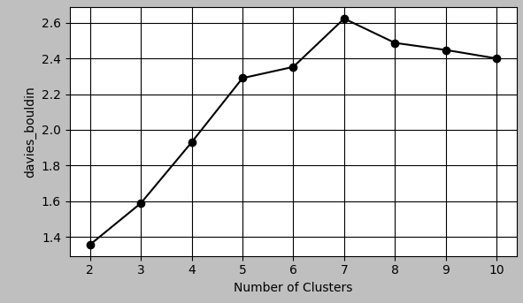
2 Gaussian Mixture Model
Step 1: Determine K value
Search for the most suitable
number of clusters.
We define the number of
clusters k from 2 to 11.
Silhouette Score
CHI
DBI

Slide 19
2 Gaussian Mixture Model
Covariance Type | Silhouette Score
tied | 0.260
diag | 0.264
spherical | 0.229
full | 0.265
Step 2: Adjust Covariance Matrix

Slide 20
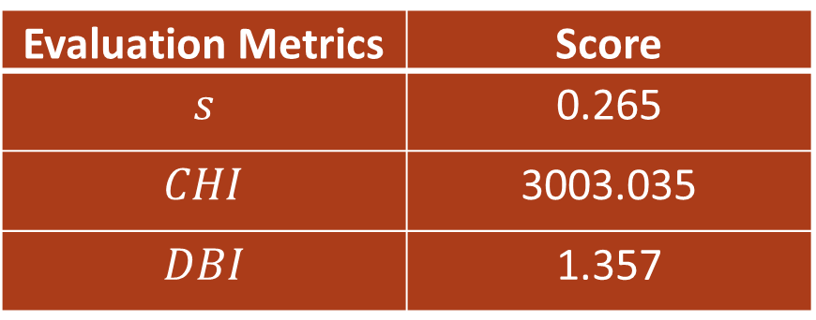
2 Gaussian Mixture Model
Evaluation Metrics | Score
$$s$$ | 0.265
$$CHI$$ | 3003.035
$$DBI$$ | 1.357
Step 3: Compute Evaluation Metrics

Slide 21
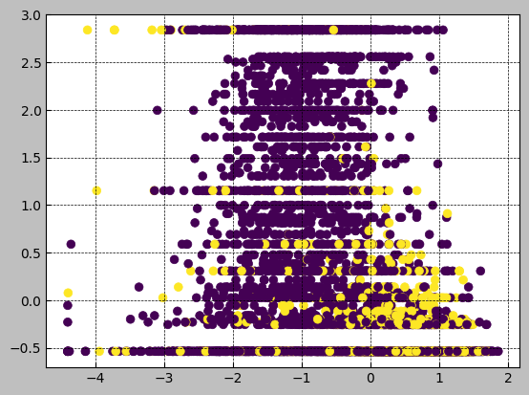
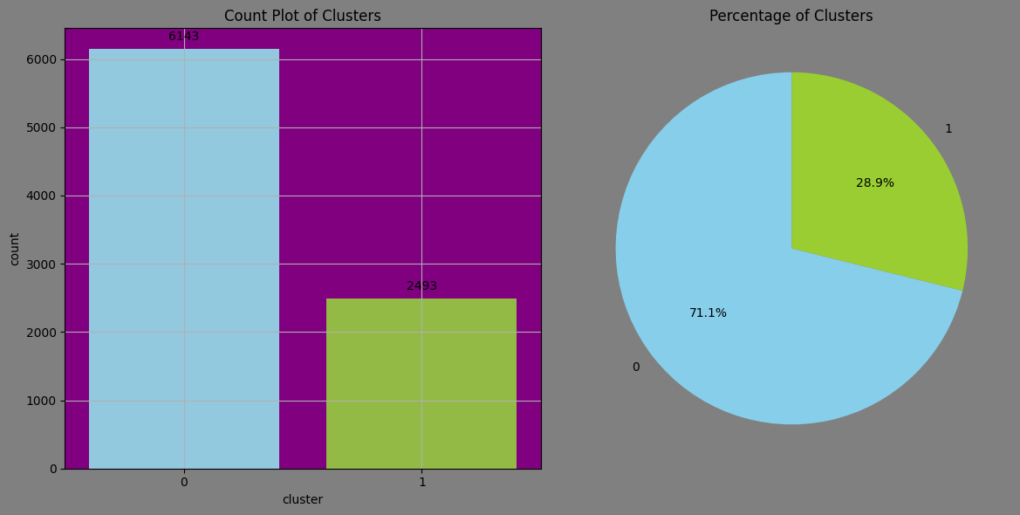
2 Gaussian Mixture Model
Step 4: Show Result
Scatter Plot
Histogram & Pie Chart

Slide 22
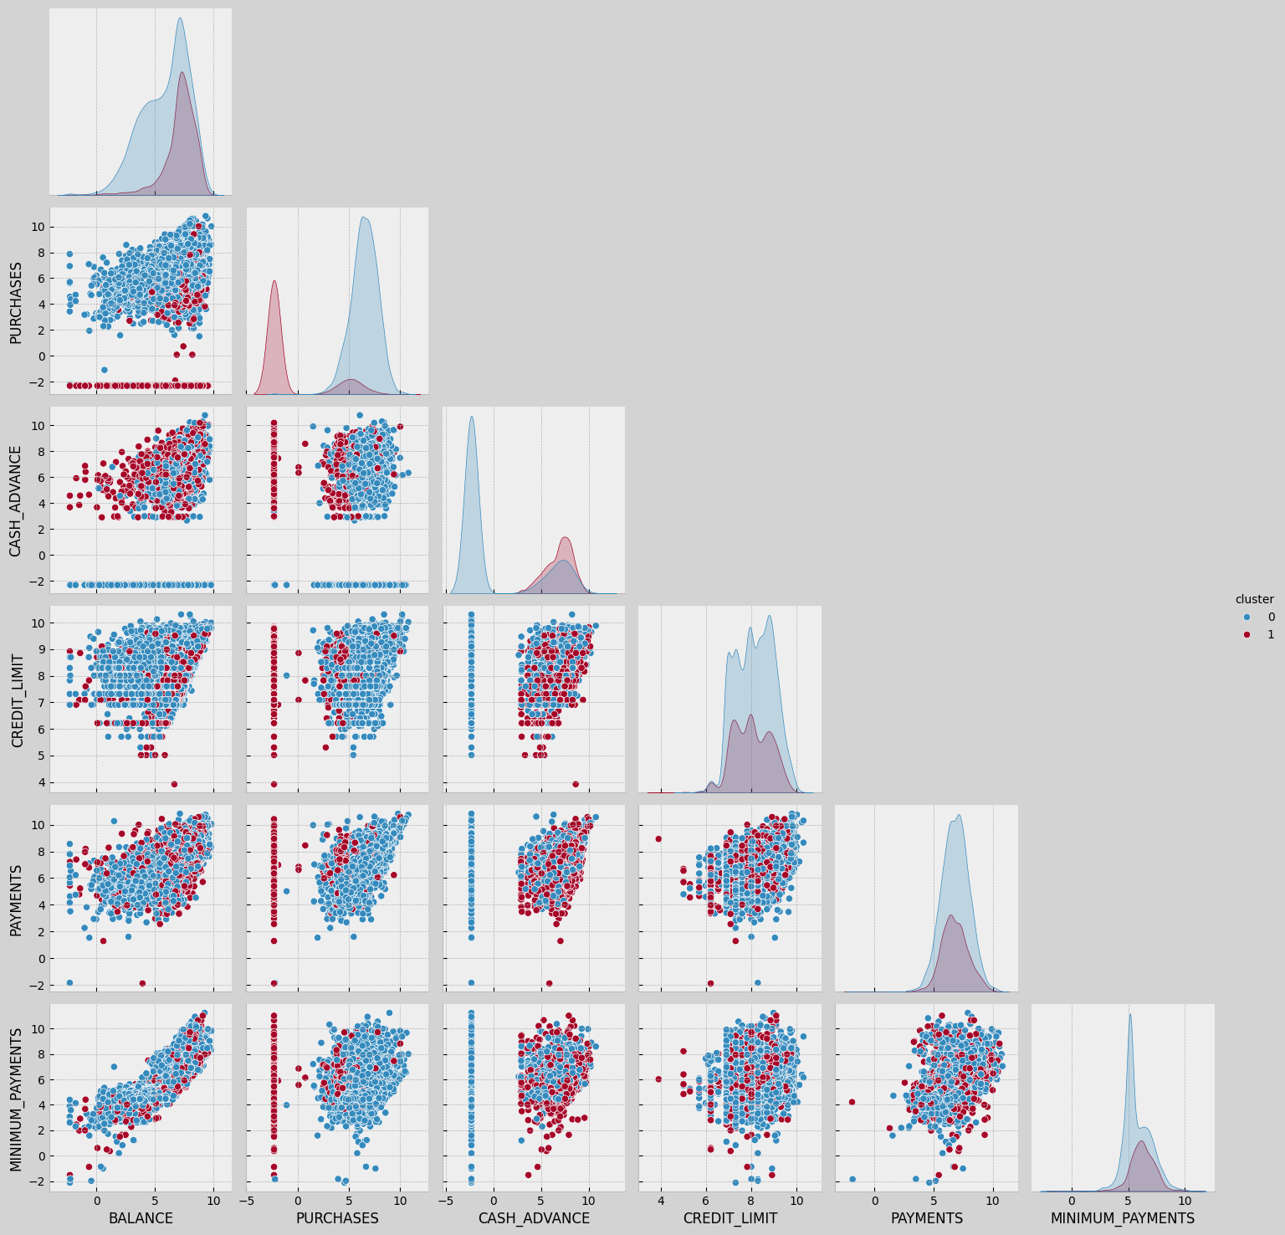
2 Gaussian Mixture Model
Pairplot

Slide 23
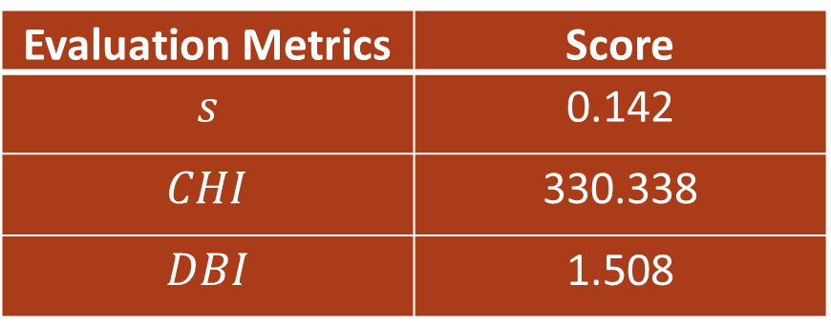
3 Affinity Propagation Model
1
2
3
Determine Parameter
Find AP_Label
Compute Evaluation Metrics
random_state=42
damp=0.9
AP.label=224
Evaluation Metrics | Score
$$s$$ | 0.142
$$CHI$$ | 330.338
$$DBI$$ | 1.508

Slide 24
4
Analysis & Conclusion
1 Analysis
2 Conclusion

Slide 25
1 Analysis
 | Silhouette Score(s) | CHI | DBI | Number of clusters
K-means | 0.2396 | 2476.4846 | 1.5397 | 3
Gaussian Mixture Model | 0.265 | 3003.035 | 1.357 | 2
Affinity Propagation Model | 0.142 | 330.338 | 1.508 | 224
1
2
3
The clustering results of different models on the same data are significantly different.
The Gaussian Mixture Model performs best among the three evaluation metrics.
The Affinity Propagation Model isn't useful for this cluster task.

Slide 26
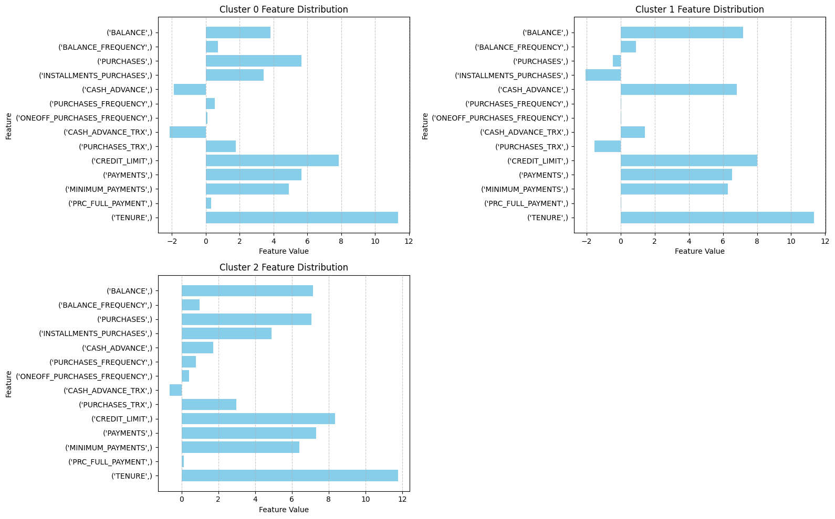
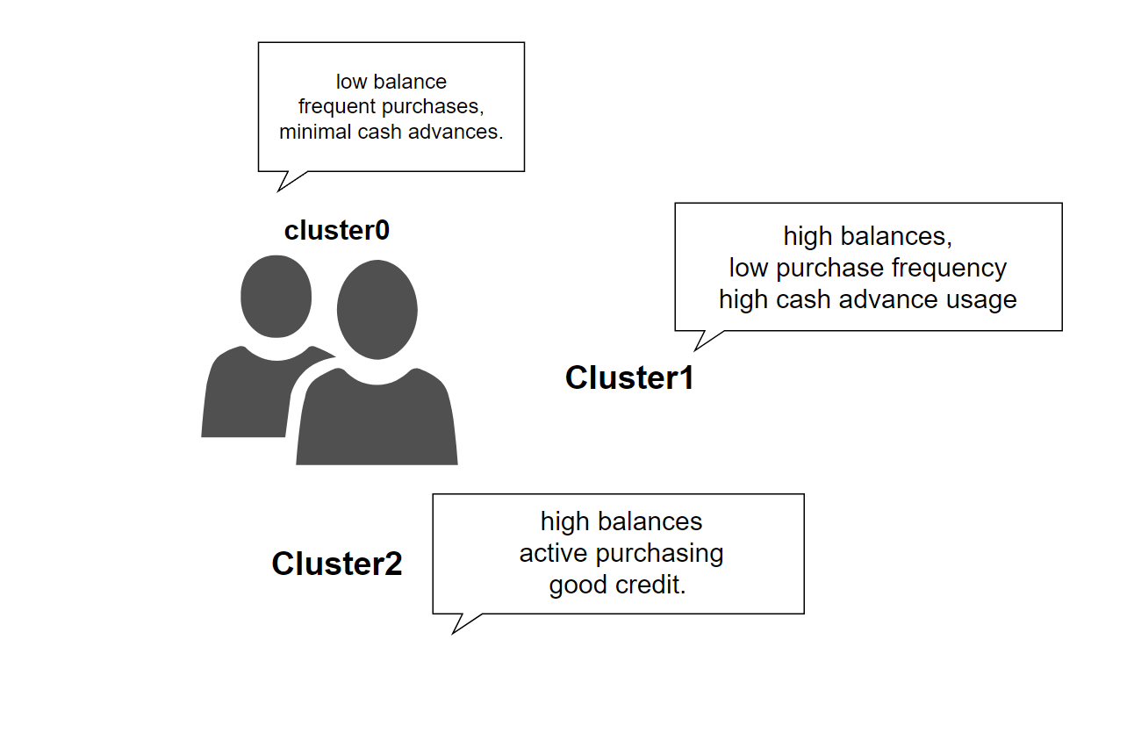
2 Conclusion—Business meaning of each cluster
PPT模板 http://www.1ppt.com/moban/
Notes:
Cluster2 用户的信用卡余额高，购物活跃，信用良好。这些用户虽然信用卡余额高，但与聚类1不同的是，他们购买频率高，尤其是分期购买。

Slide 27
Thank you
23050994g ZHANG Yian
23052341g FAN Ziyao

